Slide 1
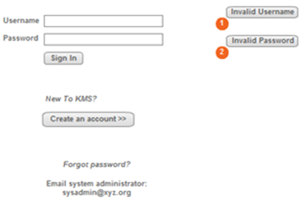
KMS
(bgcolor="#669900“)
bgcolor="#0099FF"
@2011 KMS Inc (bgcolor="#CCCC00“)

Slide 2
1.That’s the kmslogin
bg colours are indicative only, please chance colours as you like.
http://www.colorcombos.com/combolibrary.html
2. Use CSS stylesheet for layout.
3. Error messages for invalid username and password.
Use JavaScript for validation.
4. If user clicks ‘create an account’ then registration page must come up.
Kmsregister as shown in the next slide.

Slide 3
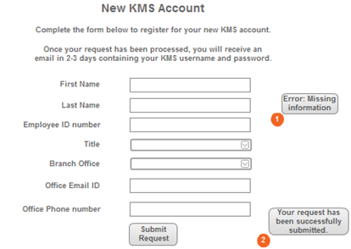
KMS
(bgcolor="#669900“)
bgcolor="#0099FF"
@2011 KMS Inc (bgcolor="#CCCC00“)

Slide 4
Dropdown menu title will have:
Business Analysts
Systems Analysts
Infrastructure Analysts
Change Analysts
2) Dropdown menu branch office will have:
Bangalore
New York
Madrid
Waterford
3) Once registered and logged in, there 2 levels of user access (employee and manager).
So, a employee a sees a different page from the manager after login.
4) Employee will see their profile information
(Name, email, phone, branch, title, experience and qualifications)
5) Manager will see a drop down menu to populate a list of analysts by title or type
(as point one above)

Slide 5
KMS
(bgcolor="#669900“)
My Profile | Edit Profile Logout
Anwesh Adhikari
Phone: +353 51 83 4021
Email: aadhikari@tssg.org
Consultant Type
Business Analyst
Branch
Waterford
Qualifications
B.E
H.Dip
M.Sc
MBA
Experience at
this position
3 years
@2011 KMS Inc (bgcolor="#CCCC00“)

Slide 6
1. That’s the page employee will see.
For the 1st time login they won’t see qualification(s).
2. Work experience will be derived from
u_start_date date, (date the account was created for that title)
u_end_date date, (current date)
From user_title table
On the other hand, when a manager logs in, he/she will see
a dropdown menu instead of the profile - options as listed in slide 4.
When they select say business analyst then a list of all business analyst
is generated on the same page.
4. The objective here is the employee updates their profile while a manager
views the profiles for resource allocation to projects.
5. An employee can have more than one qualification to display.

Slide 7
KMS
//Edit page
(bgcolor="#669900“)
My Profile | Edit Profile Logout
Anwesh Adhikari
Phone: +353 51 83 4021
Email: aadhikari@tssg.org
//Dropdown menu. 4 options. Display 1.
Consultant Type
Business Analyst
Branch
Waterford
//Dropdown menu. 4 options. Display upto 4.
Qualifications
B.E
H.Dip
M.Sc
MBA
Experience at
this position
3 years
Update Profile
@2011 KMS Inc (bgcolor="#CCCC00“)

